Slide 1


Quantum Calculator
by using qutrit
Team Sogang’s Cat
Notes:
Our

Slide 2
Team members

Slide 3
CONTENTS
01. Challenge Problem
02. Issues and Our Attempts
03. Future Follow-ups

Slide 4
01. Challenge Problem
Team Sogang’s Cat
IBM Challenge Topic #1
Build your minimal quantum circuit
- Making a quantum calculator

Slide 5
Build your minimal quantum circuit
-> Making a quantum calculator
Build a minimal 4-digit numbers quantum adder circuit
Try to reduce the error of the adder on the real device,
IBM Quantum Systems, as much as possible.
Additional challenge:
Try to make the UI of a quantum calculator.
* The number of QPUs is limited to 7

Slide 6
02. Issues and Our Attempts
Team Sogang’s Cat
IBM Challenge Topic #1
Build your minimal quantum circuit
- Making a quantum calculator

Slide 7
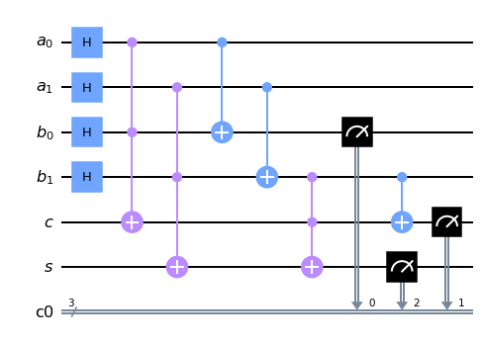
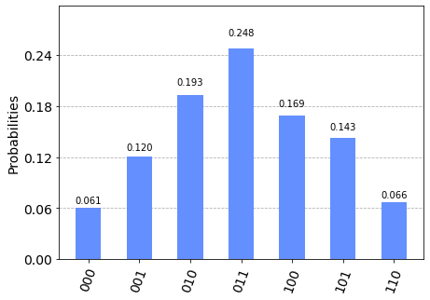
Qiskit Realization of 2-digit adder

Slide 8
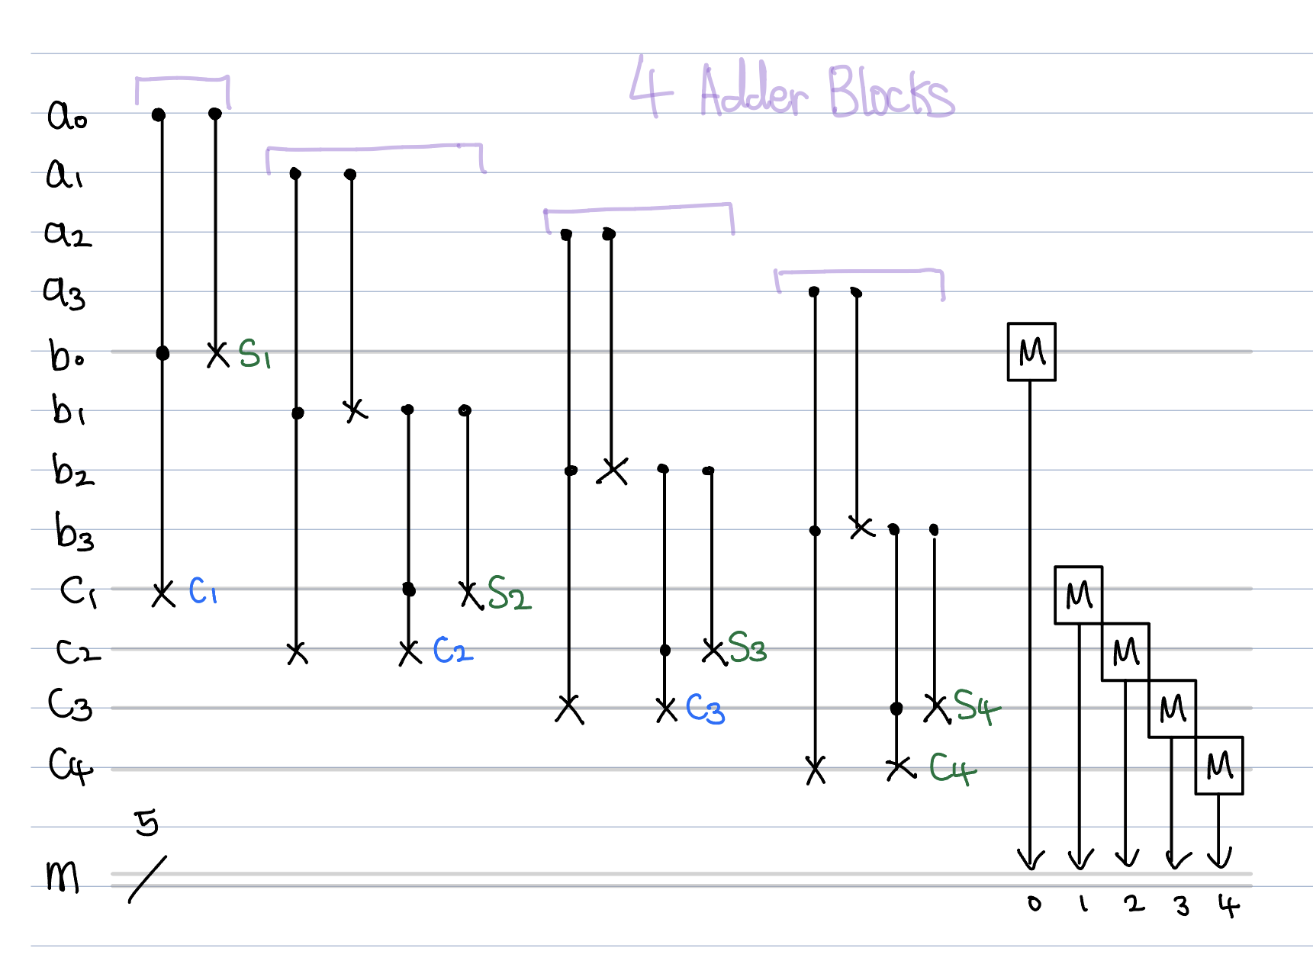
Qubit 4-digit Adder
[Issue]
# of QIU (7)
< # of necessary qubits (12)
*QIU: Quantum Information Unit

Slide 9
Quantum Information Unit
qubit
qutrit
qudit

Slide 10
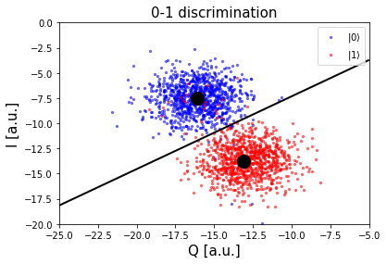
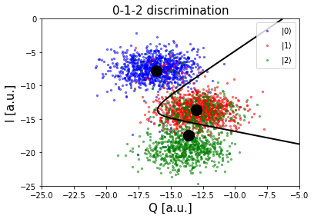
Qutrit

Slide 11

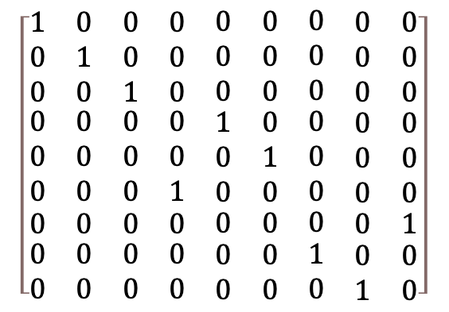
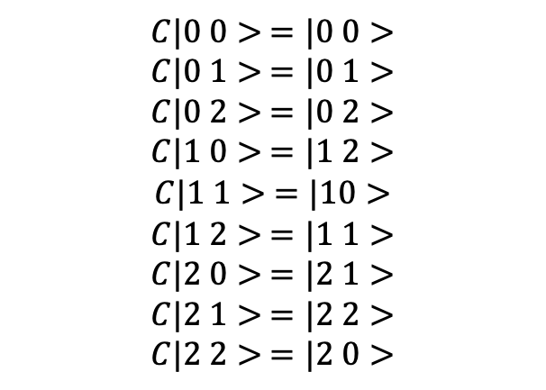
Qutrit Gates
Example: CNOT
$$CNOT |x, y> =|x, \left(x⊕y\right) mod 2>, (x,y=0 or 1)$$
$$CNOT |x, y> =|x, \left(x⊕y\right) mod 3>, (x, y=0 ,1 or 2)$$
$$C|0 0> =|0 0>$$
$$C|0 1> =|0 1>$$
$$C|0 2> =|0 2>$$
$$C|1 0> =|1 2>$$
$$C|1 1> =|10>$$
$$C|1 2> =|1 1>$$
$$C|2 0> =|2 1>$$
$$C|2 1> =|2 2>$$
$$C|2 2> =|2 0>$$
$$\left[\begin{matrix}\begin{matrix}\begin{matrix}1 & 0 \\ 0 & 1 \\ 0 & 0\end{matrix} & \begin{matrix}0 & 0 \\ 0 & 0 \\ 1 & 0\end{matrix} \\ \begin{matrix}0 & 0 \\ 0 & 0 \\ 0 & 0\end{matrix} & \begin{matrix}0 & 0 \\ 0 & 0 \\ 0 & 1\end{matrix}\end{matrix} & \begin{matrix}\begin{matrix}0 & 0 \\ 0 & 0 \\ 0 & 0\end{matrix} & \begin{matrix}0 & \begin{matrix}0 & 0\end{matrix} \\ 0 & \begin{matrix}0 & 0\end{matrix} \\ 0 & \begin{matrix}0 & 0\end{matrix}\end{matrix} \\ \begin{matrix}1 & 0 \\ 0 & 1 \\ 0 & 0\end{matrix} & \begin{matrix}0 & \begin{matrix}0 & 0\end{matrix} \\ 0 & \begin{matrix}0 & 0\end{matrix} \\ 0 & \begin{matrix}0 & 0\end{matrix}\end{matrix}\end{matrix} \\ \begin{matrix}\begin{matrix}0 & 0\end{matrix} & \begin{matrix}0 & 0\end{matrix} \\ \begin{matrix}0 & 0 \\ 0 & 0\end{matrix} & \begin{matrix}0 & 0 \\ 0 & 0\end{matrix}\end{matrix} & \begin{matrix}\begin{matrix}0 & 0\end{matrix} & \begin{matrix}0 & \begin{matrix}0 & 1\end{matrix}\end{matrix} \\ \begin{matrix}0 & 0 \\ 0 & 0\end{matrix} & \begin{matrix}1 & \begin{matrix}0 & 0\end{matrix} \\ 0 & \begin{matrix}1 & 0\end{matrix}\end{matrix}\end{matrix}\end{matrix}\right]$$

Slide 12
Ternary addition
SUM | 0 | 1 | 2
0 | 0 | 1 | 2
1 | 1 | 2 | 0
2 | 2 | 0 | 1
CARRY | 0 | 1 | 2
0 | 0 | 0 | 0
1 | 0 | 0 | 1
2 | 0 | 1 | 1

Slide 13
03. Future Follow-ups #1
Team Sogang’s Cat
IBM Challenge Topic #1
Error Correction

Slide 14
03. Future Follow-ups #2
Team Sogang’s Cat
IBM Challenge Topic #1
Building necessary qutrit gates (single/multiple)
Construct arithmetic machine using qutrit gates

Slide 15
Quantum Calculator
by using qutrit

Slide 16
Go Q-computer!
Team Sogan;’s Cat

